Slide 1
User Manual
EATOP Allocation Assistant

Slide 2
Limitations
The ’Hint!’ functionality does not work if in the workspace an element is contained in more than one model (e.g. requirements model and system model contain the same elements, the comparison will find difference in memory address and will not work properly ).
You can use the example models (testModel.eaxml and testRequirements.eaxml) placed in the documentation folder

Slide 3
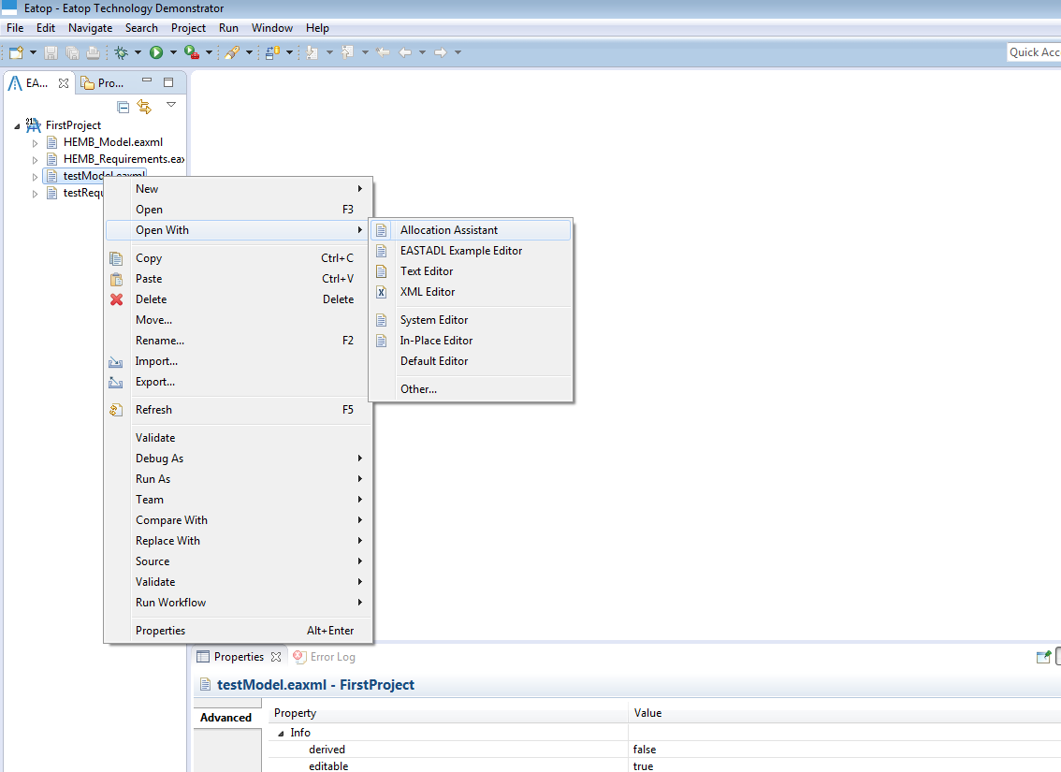
Open Allocation Assistant – Right-click on the system model file and choose ”Open With” -> ”Allocation Assistant”

Slide 4
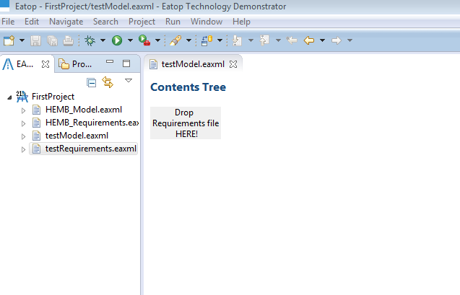
Open the AllocationAssistant – Drag the requirements .eaxml file on the gray area ”Drop Requirements file HERE!” (It works just if and .eaxml file it’s dropped!)

Slide 5
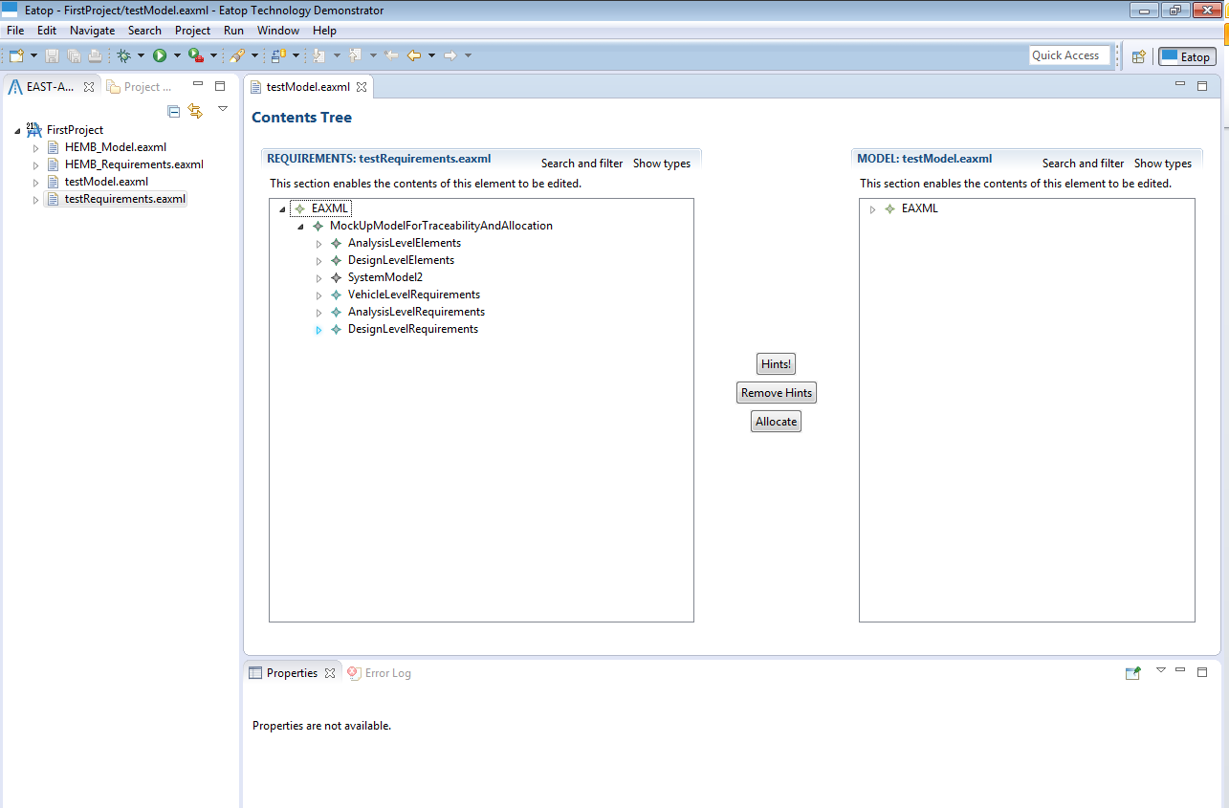
Expanding elements – click on the arrows to expand elements on both tree views

Slide 6
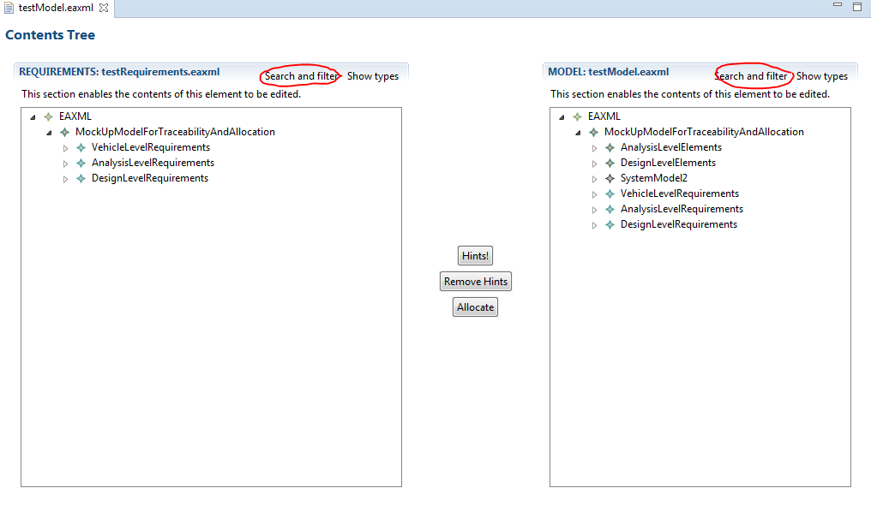
Search and filter – use search and filter to find the elements by type and attribute. Use have the same functionality for both requirements and model tree view. The next two pages shows examples of searching and filtering.

Slide 7
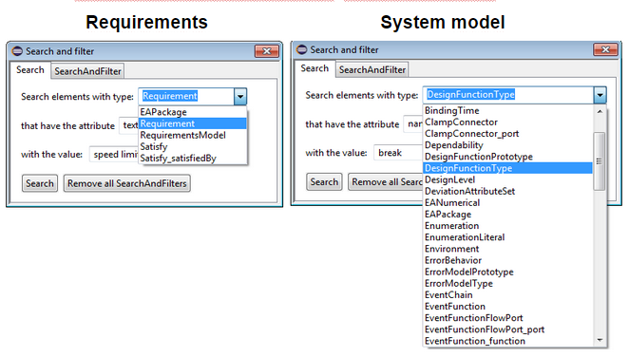
Search by type and attibute value – examples of search for both requirements and model tree view.

Slide 8
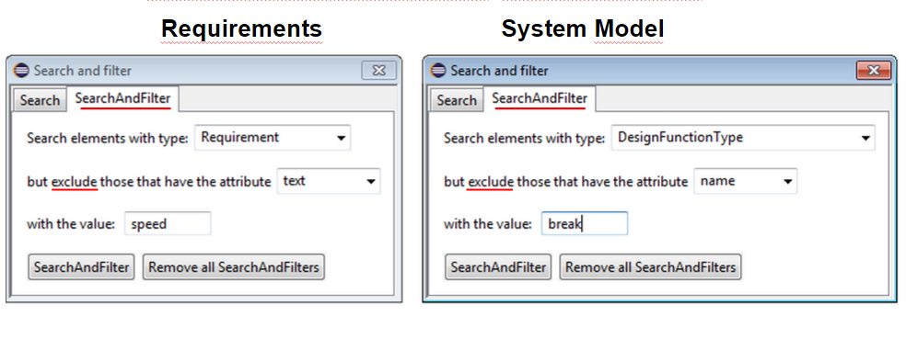
Search by type and EXCULDE by attibute value – examples of search and filter for both requirements and model tree view.

Slide 9
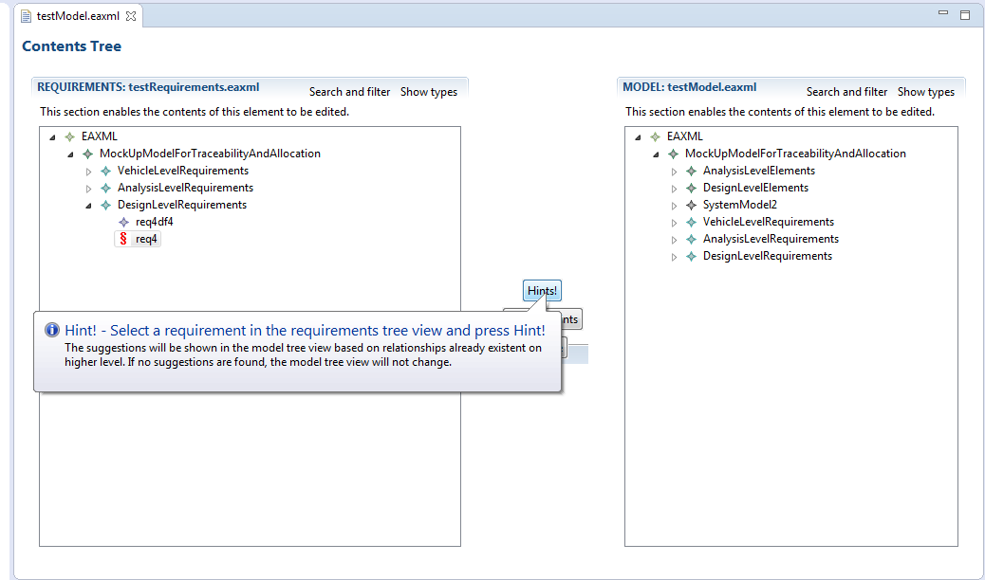
Using Hints! – get allocation suggestions by selecting one requirements in the requirements tree view and pressing ”Hints!”

Slide 10
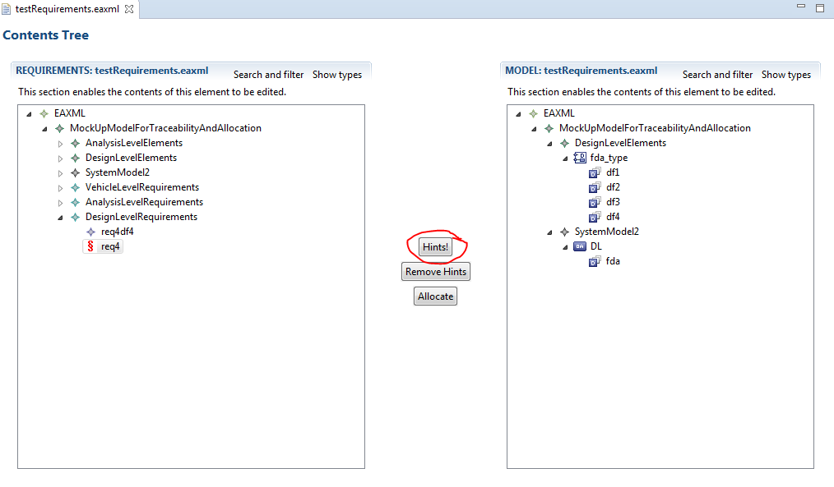
Using hints - result

Slide 11
The logic behind hints based on the model example used
Requirements
System model
Analysis
Function 3
req2
Analysis
Function 4
req3
req5
Analysis
Function 2
Analysis
Function 1
Higher level
df1
Hint!
Current level
fda
Hint!
df3
Hint!
Selected
req4
df2
Hint!
df4
Hint!
DeriveRequirement
Satisfy
Realization

Slide 12
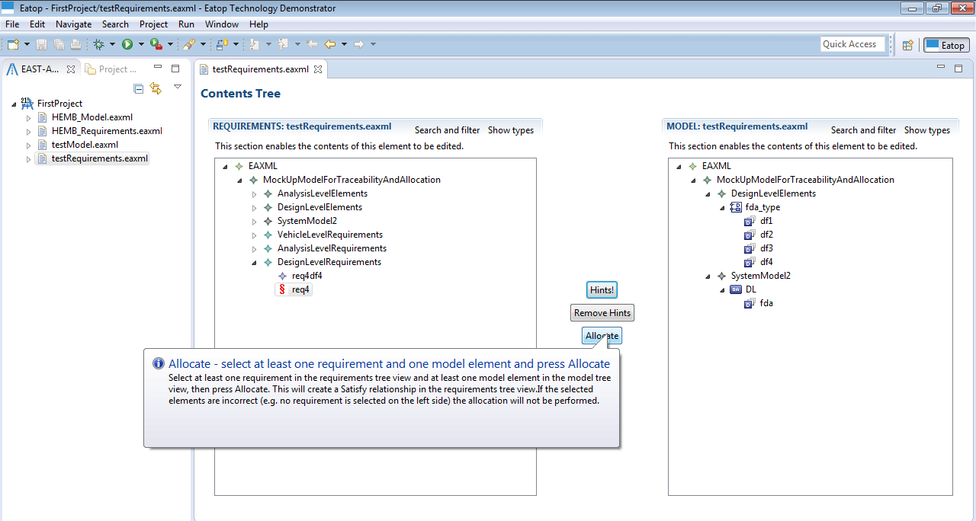
Allocation Funtionality

Slide 13
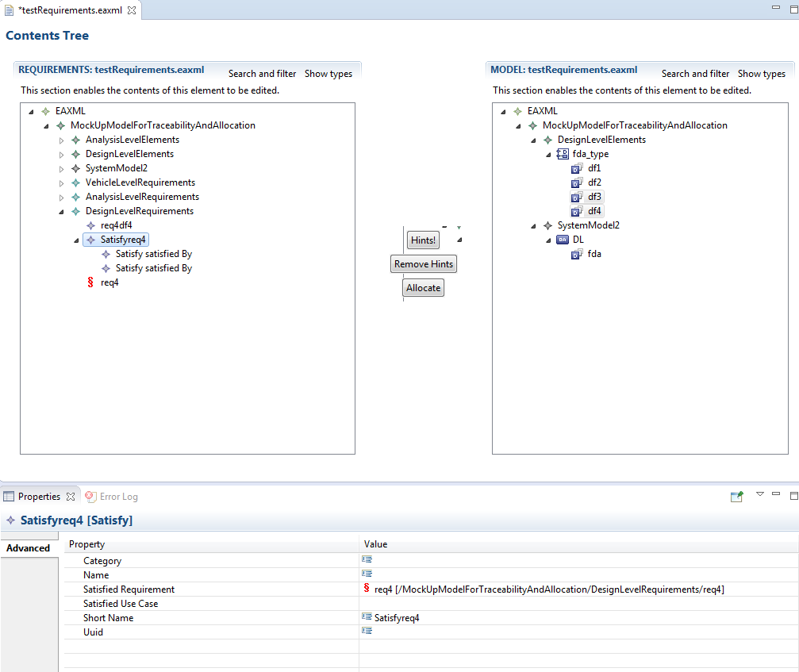
Allocation result – A Satisfy link that has in SatisfiedRequirement the selected requirement

Slide 14
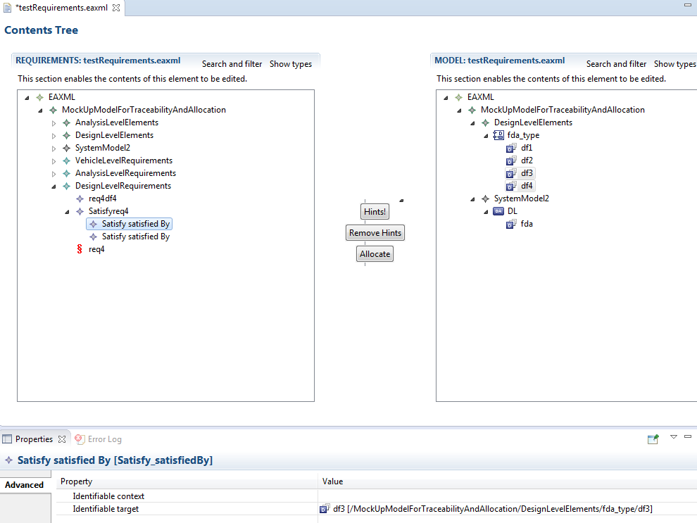
Allocation Result – Under Satisfy there are 2 Satisfy_SatisfiedBy, each pointing to the selected elements in the system model treeview

